Slide 1


CONTROLLING MONITER USING HAND-GESTURES

Slide 2
1
AIM OF THE PROJECT
2
COMPONENTS USED
Contents
3
Contents
WORKING
4
ADVANTAGES & DISADVANTAGES

Slide 3
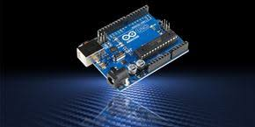
AIM
This project introduces an application using computer vision for hand gestures.
Gesture control is the ability to recognize and interpret
movements of the human body in order to interact with and
control a computer system without direct physical contact.
With this project we can handle some of the features in our
computer/laptop just by sitting in your chair and keeping some
gestures,you can also play some games using this.
of the project

Slide 4
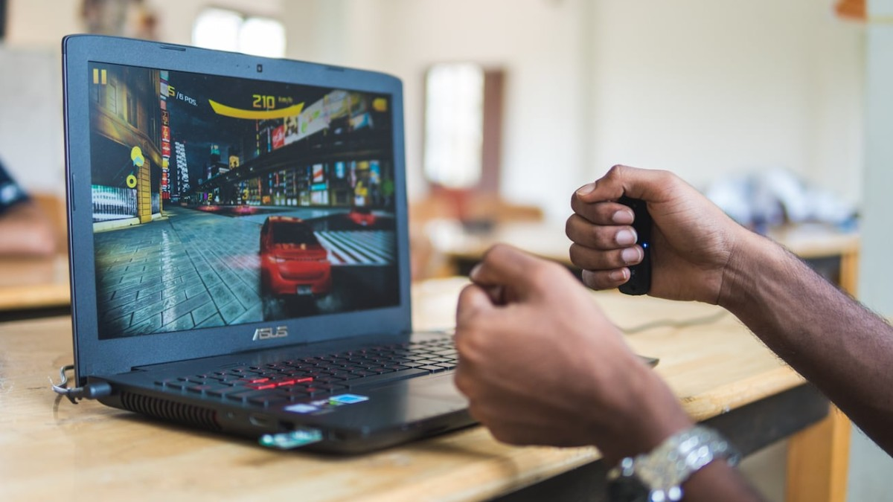
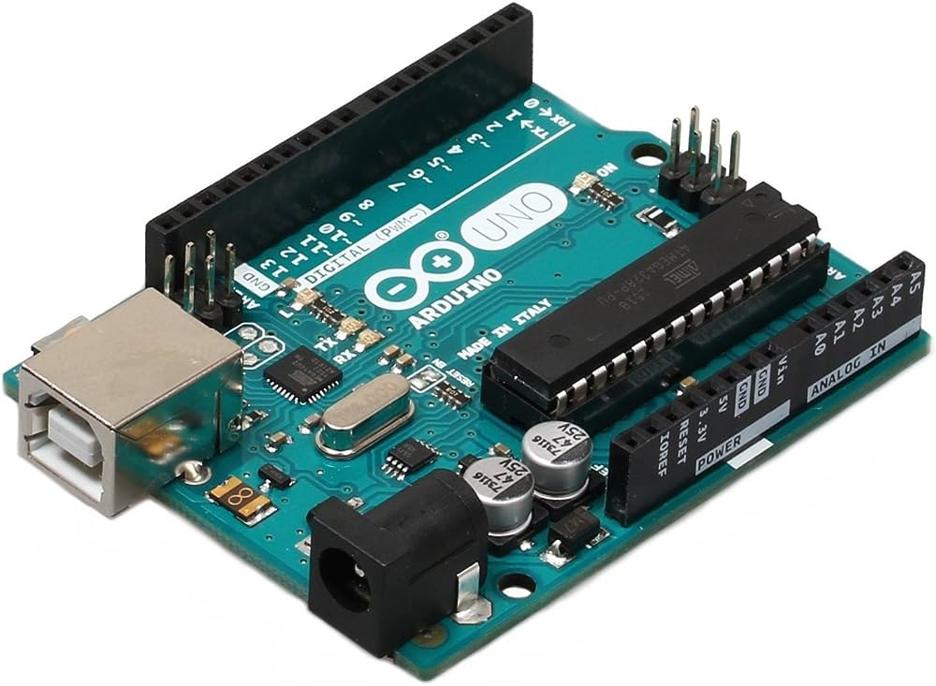
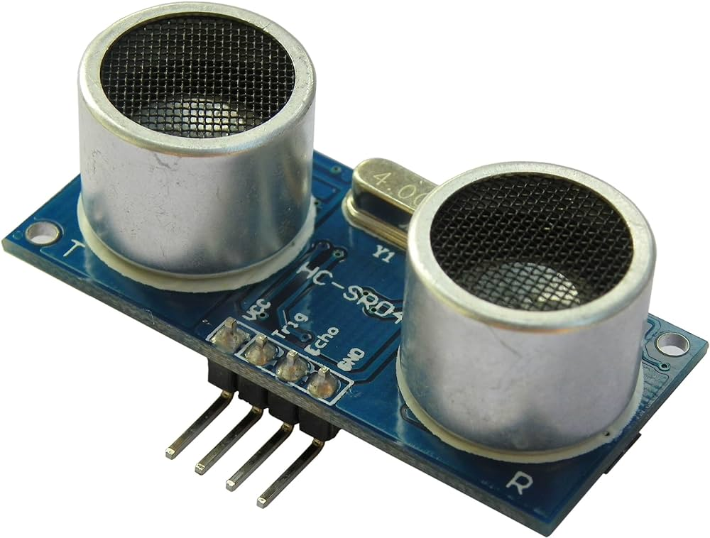
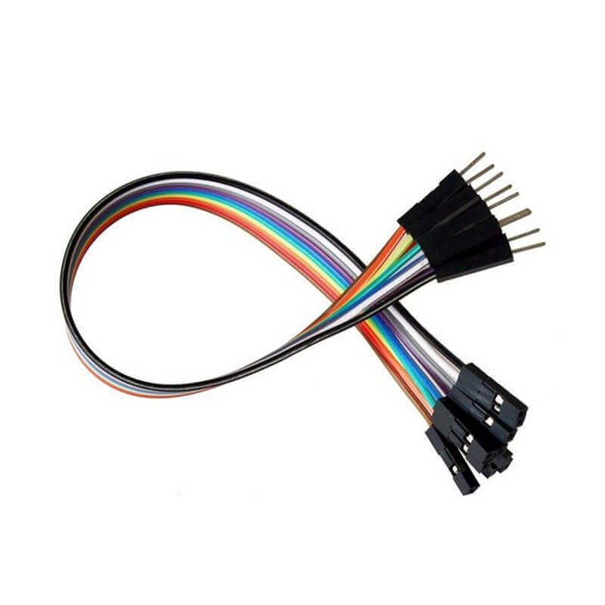
COMPONENTS USED
Jumper
wires
Arduino
2-ultrasonic
sensors

Slide 5
WORKING
The process typically involves:
1) Gesture Recognition: Sensors or cameras capture hand movements, and software algorithms interpret these movements into recognizable gestures.
2) Data Processing: The captured gesture data is processed through machine learning algorithms or predefined gesture libraries to identify specific gestures accurately.
3) Command Mapping: Each recognized gesture is mapped to a predefined action or command, allowing users to control devices, applications, or systems.
4) Execution: Once a gesture is recognized and associated with an action, the system executes the corresponding task, such as controlling a computer interface, navigating through presentations, or operating IoT devices.

Slide 6
THE CODE USED FOR THIS PROJECT:
#include <Ultrasonic.h>
const int trigPinUpDown = 2;
const int echoPinUpDown = 3;
const int trigPinLeftRight = 4;
const int echoPinLeftRight = 5;
Ultrasonic ultrasonicUpDown(trigPinUpDown, echoPinUpDown);
Ultrasonic ultrasonicLeftRight(trigPinLeftRight, echoPinLeftRight);
long duration;
int distanceUpDown, distanceLeftRight;
unsigned long temp = 0;
void find_distances(void);
void setup()
{
Serial.begin(9600);

Slide 7
pinMode(trigPinUpDown, OUTPUT);
pinMode(echoPinUpDown, INPUT);
pinMode(trigPinLeftRight, OUTPUT);
pinMode(echoPinLeftRight, INPUT);
delay(1000);
}
void loop()
{
find_distances();
if (distanceUpDown <= 40 && distanceUpDown >= 20)
{
delay(2000);
find_distances();
if (distanceUpDown <= 20 && distanceUpDown >= 0)
{
Serial.println("down");
Serial.println(distanceUpDown);
}
}

Slide 8
if (distanceUpDown <= 20 && distanceUpDown >= 0)
{
delay(2000);
find_distances();
if (distanceUpDown <= 40 && distanceUpDown >= 20)
{
Serial.println("up");
// Send distance data to Python script
Serial.println(distanceUpDown);
}
}
if (distanceLeftRight <= 40 && distanceLeftRight >= 20)
{
delay(2000);
find_distances();
if (distanceLeftRight <= 20 && distanceLeftRight >= 0)
{
Serial.println("left");
Serial.println(distanceLeftRight);
}
}

Slide 9
if (distanceLeftRight <= 20 && distanceLeftRight >= 0)
{
delay(2000);
find_distances();
if (distanceLeftRight <= 40 && distanceLeftRight >= 20)
{
Serial.println("right");
Serial.println(distanceLeftRight);
}
}
}
void find_distances(void)
{
distanceUpDown = ultrasonicUpDown.read();
distanceLeftRight = ultrasonicLeftRight.read();
delay(100);
}

Slide 10
ANOTHER CODE FOR RUNNING IN PYTHON:
import serial
import pyautogui
# Initialize serial port
Arduino_Serial = serial.Serial('com5', 9600)
while True:
# Read serial data and decode
incoming_data = Arduino_Serial.readline().decode("utf-8").strip()
# Print incoming data
print(incoming_data)
# Perform actions based on incoming data
if 'next' in incoming_data:
pyautogui.hotkey('ctrl', 'pgdn')
elif 'previous' in incoming_data:
pyautogui.hotkey('ctrl', 'pgup')
elif 'down' in incoming_data:
pyautogui.press('down')
elif 'up' in incoming_data:
pyautogui.press('up')
elif 'change' in incoming_data:
pyautogui.keyDown('alt')
pyautogui.press('tab')
pyautogui.keyUp('alt')
# Close the serial connection when done (optional)
# Arduino_Serial.close()

Slide 11
Advantages:
1) Intuitive interaction
2) Accessibility
3) Hands-free Operation
4) Enhanced User Experience
5) Innovative Applications
6) Reduced Contamination Risk
ADVANTAGES
DISADVANTAGES
Disadvantages:
1) Complexity and Learning Curve
2) Limited Precision and Accuracy
3) Environmental Sensitivity
4) Dependency on Technology
5) Privacy Concerns
6) Limited Range and Context Sensitivity
7) Cost

Slide 12
THE END
By:- Kankshitha(2201CS51)
SriHari(2201MC35)

